Slide 1
Some logistics
I’ll be in room 153 (next door) nearly every week day. Feel free to join me any time!
Video is posted shortly after class to forum thread
You can join class remotely up to 2 times if you have to
Please ask questions or add comments through forums
Questions with 3+ likes will be asked by Rachel, so be sure to ‘like’ anything you want to see addressed
If you aren’t sure whether to ask – just ask anyway! There are no stupid questions ☺

Slide 2
Get to know the forum
Shift-r to reply; Ctrl-enter to send
Replies are instant: join the ‘lesson 8 in-class’ thread now!
You can watch and pin threads
Try creating a thread for your area of interest, for ongoing discussion
Create a study group in your area / time-zone
There might already be one for you – check the forum

Slide 3
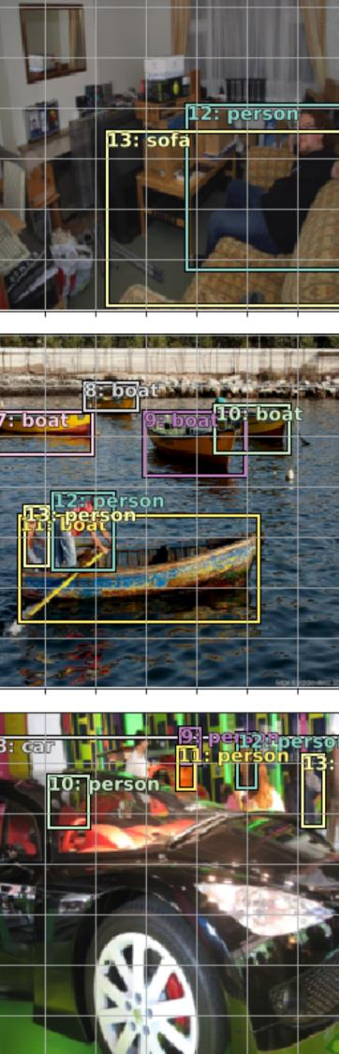
Lesson 8
Object Detection

Slide 4
What we’ve learnt so far
Transfer Learning
Differentiable layers
Architecture design
Handling over-fitting
Embeddings

Slide 5
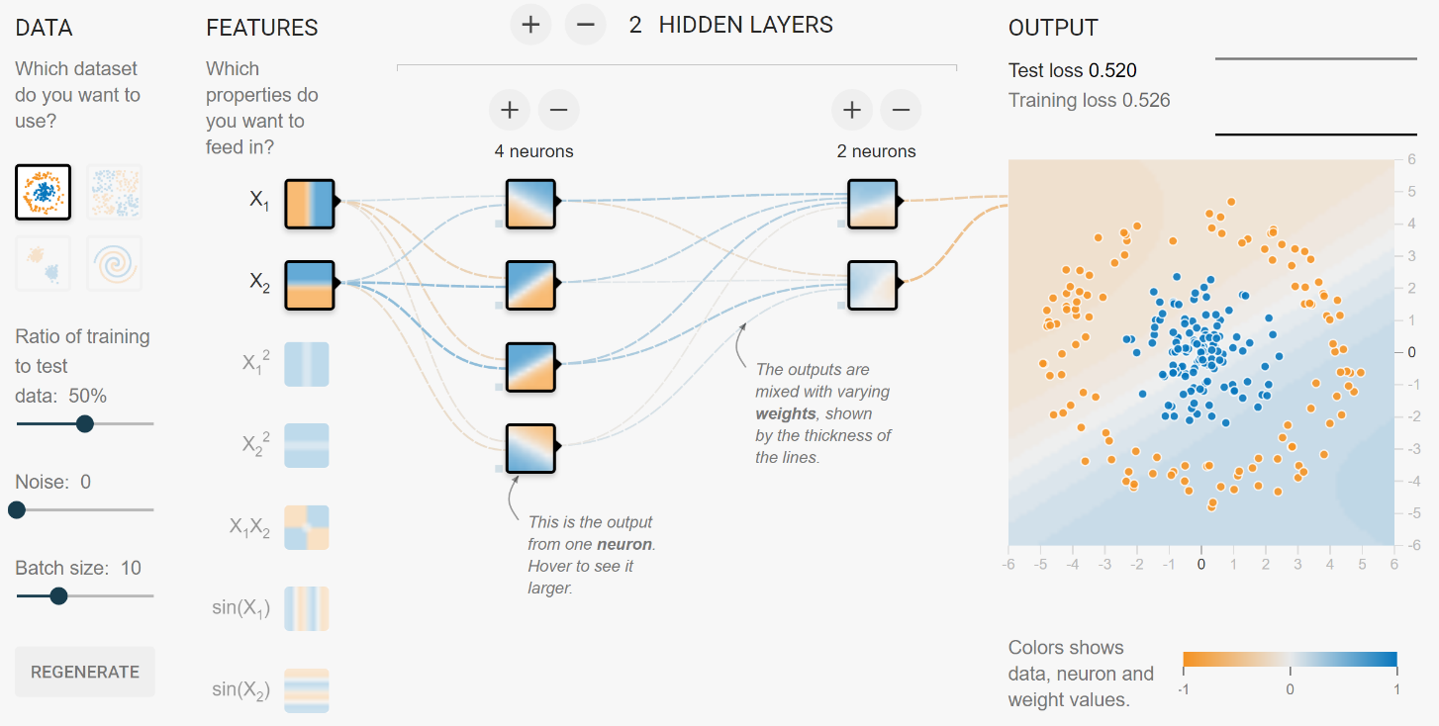
Stacks of differentiable non-linear functions with lots of parameters solve nearly any predictive modeling problem
https://playground.tensorflow.org

Slide 6
Transfer learning makes nearly everything easier, faster, and more accurate
Replace last layer
Fine-tune new layers
Fine-tune more layers (optional)

Slide 7
We can adjust our architecture for the specifics of our dataset and objective
CNNs for fixed-size ordered data
RNNs for sequences
Softmax for categories
Relu for inner activations

Slide 8
Five steps to avoiding overfitting
More data
Data augmentation
Generalizable architectures
Reduce architecture complexity
Regularization

Slide 9
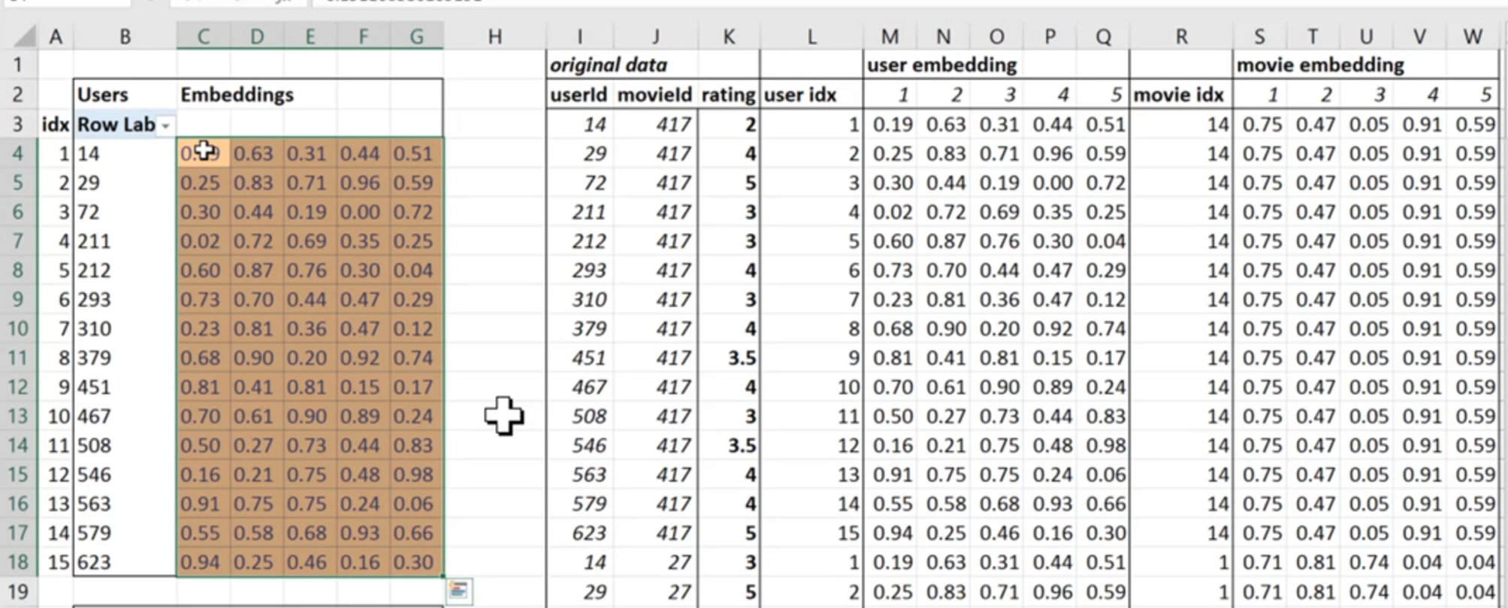
Embeddings allow us to use categorical data too

Slide 10
From part 1 “Practical” to part 2 “Cutting Edge” deep learning
Requires significant fastai customization
Need to understand python well (e.g. classes)
Other code resources will generally be research quality
Code samples online nearly always have problems
Each lesson will be incomplete – ideas to explore

Slide 11
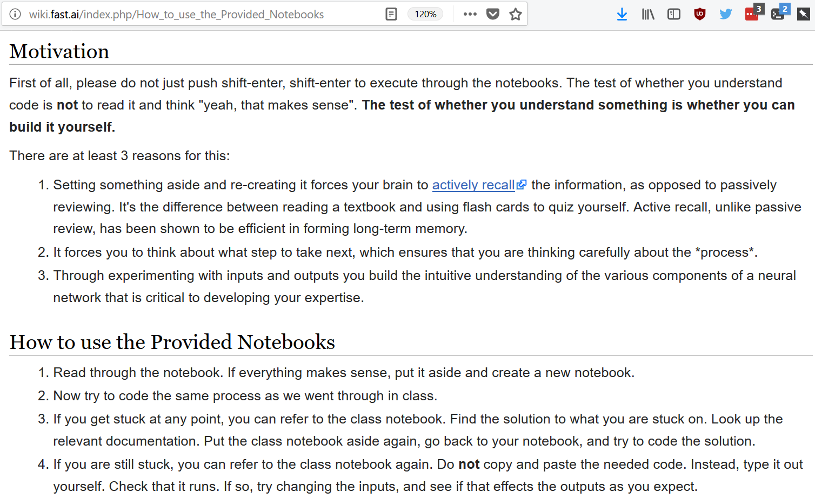

Slide 12
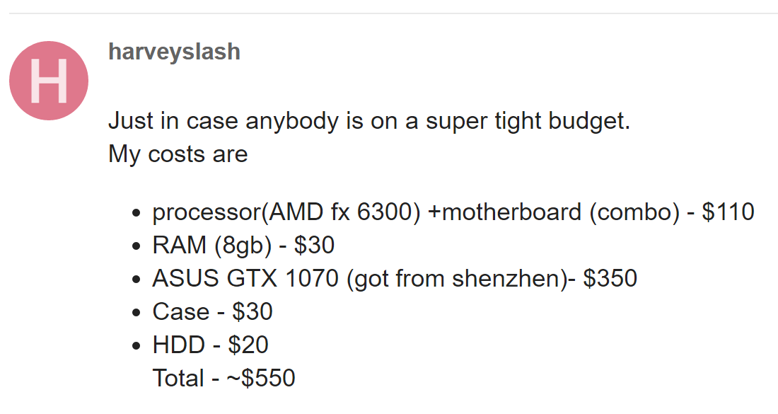
It’s time to build your own box
GPU
Plenty of RAM and good single precision
GTX 1080ti is the price performance sweet spot today
CPU and RAM
As much RAM as possible, with room for more
Make sure motherboard supports >=64GB RAM
Storage
Fast SSD for analysis and big disks for data
NVMe drives are amazing! Get the biggest you can afford
GTX 1070 also fine (8GB RAM). Used cards are fine if you can find them
i5 or i7 CPU is fine
Fill up the rest of the space with the largest standard hard-drives you can buy
The rest
pcpartpicker.com is very helpful
Make sure your power supply is more than sufficient.
Ensure you have x8 PCI lanes for each of your GPUs
Dual GPUs let you continue to prototype whilst running an experiment
A store like centralcomputers.com can put it together for you
CPU speed and cores matter (for computer vision – not for NLP)
http://forums.fast.ai/t/making-your-own-server/174

Slide 13
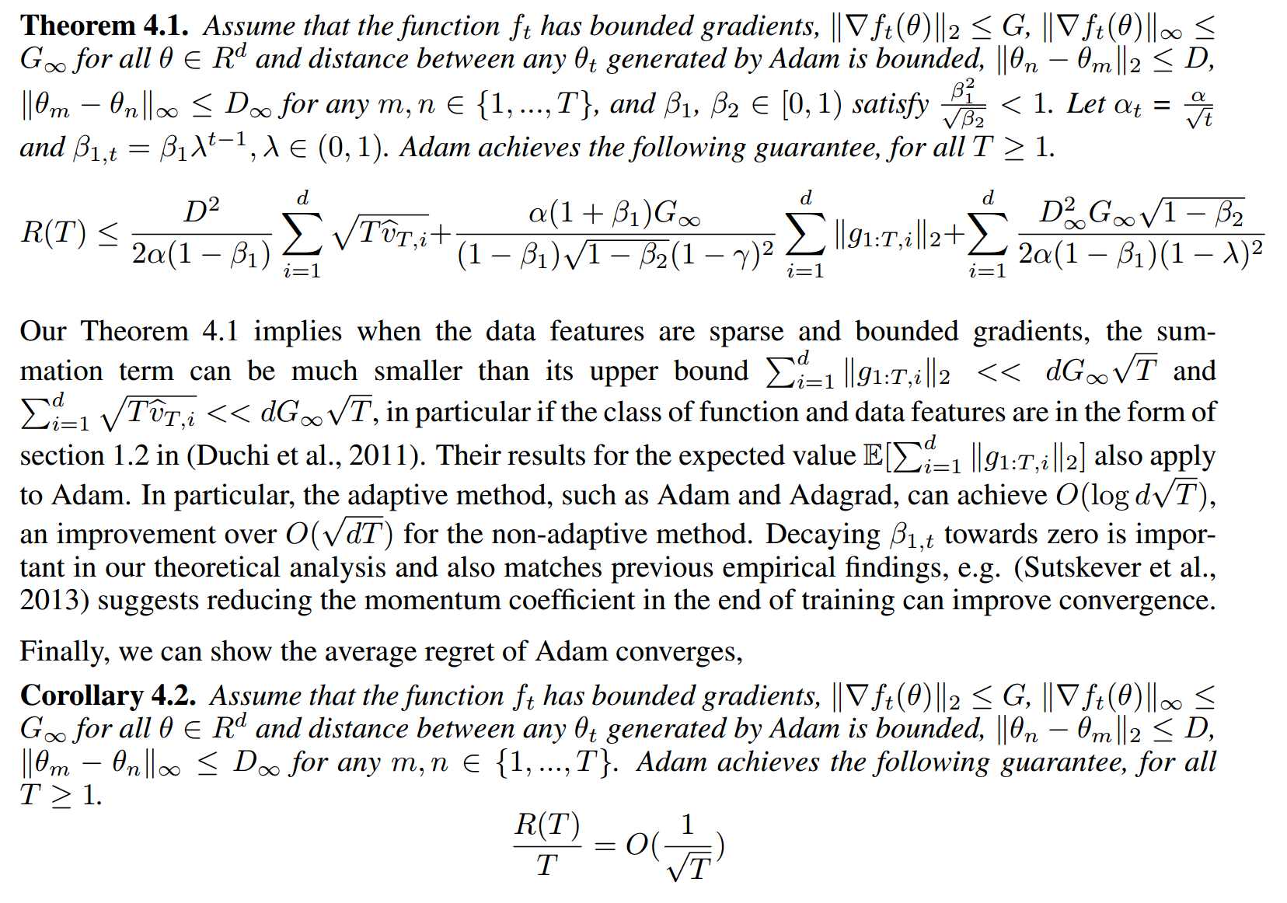
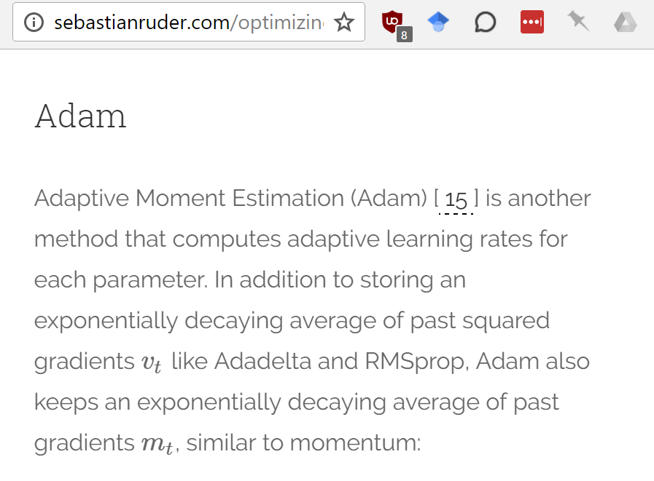
It’s time to start reading papers
Even familiar stuff looks complex in a paper!
Papers are important for deep learning beyond the basics, but hard to read
Google for a blog post describing the paper
Learn to pronounce Greek letters

Slide 14
There are many opportunities for you in this class
Your homework will be at the cutting edge
There are few DL practitioners that know what you know now
Experiment lots, especially in your area of expertise
Much of what you find will have not be written about before
Don’t wait to be perfect before you start communicating
If you don’t have a blog, try medium.com

Slide 15
What we’ll study in Part 2
Generative Models
CNNs beyond classification
Localization
Super-resolution
NLP beyond classification
Translation
Large data sets
Large images
Lots of data points
Enhancement:
Artistic style
GANs
Large outputs
Seq2seq
Attention
Colorization
Large vocabularies

Slide 16
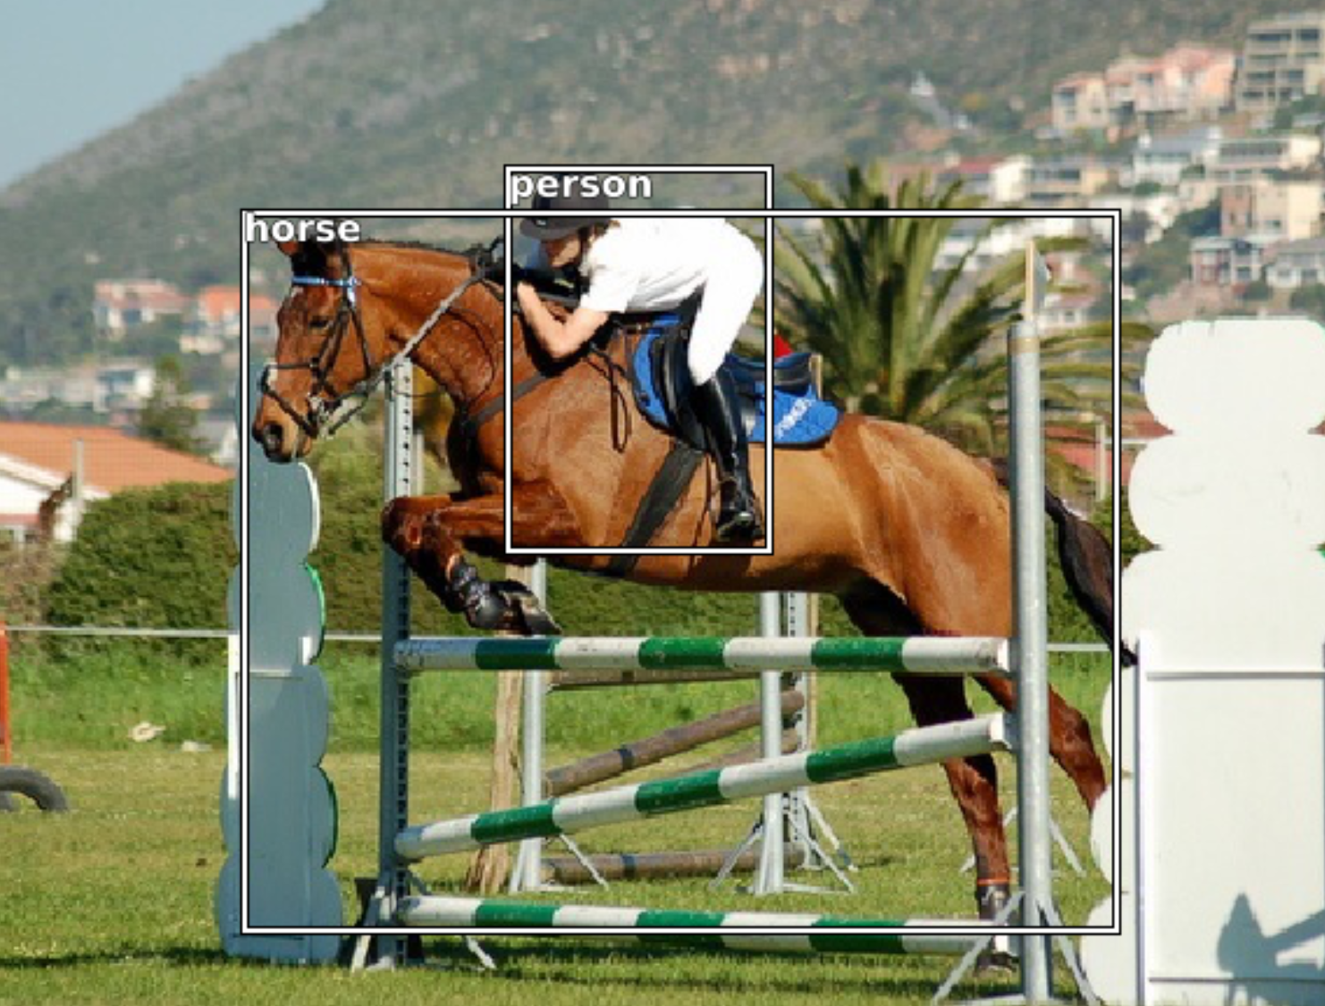
Today we will start on Object Detection

Slide 17
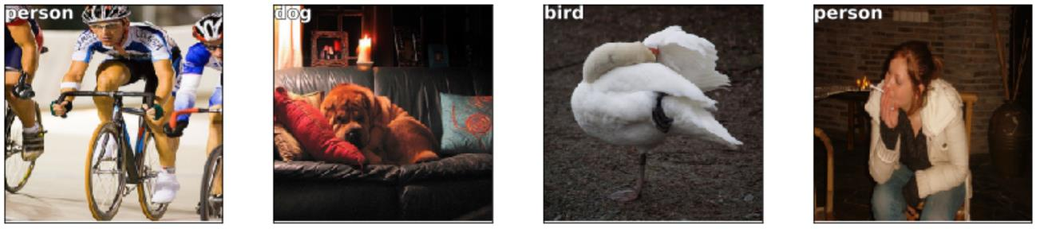
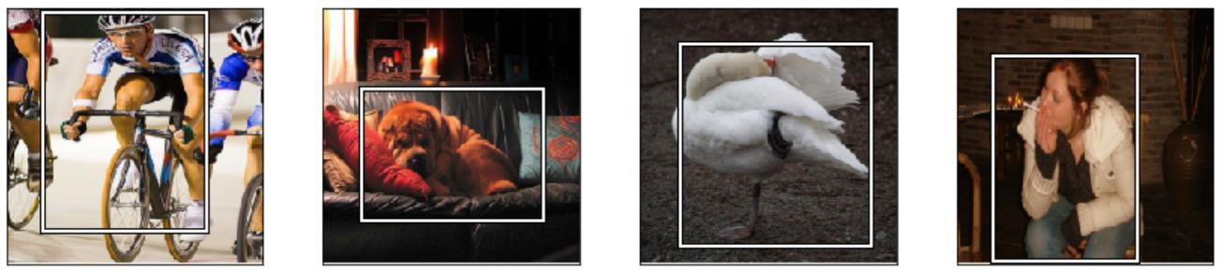
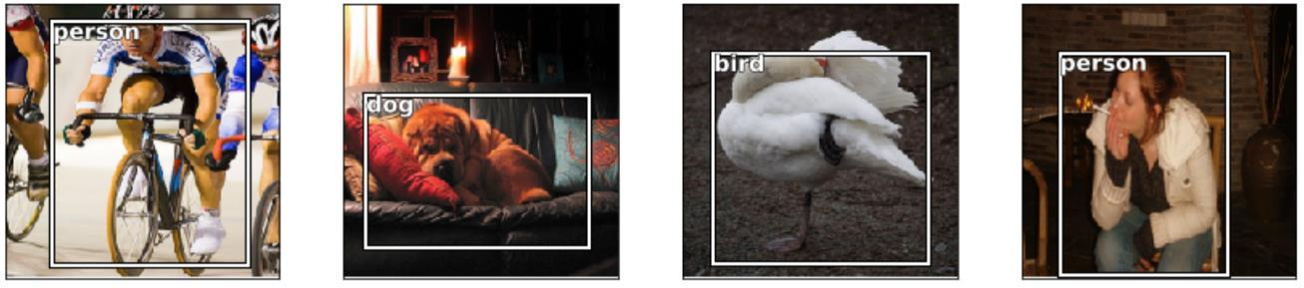
Step 1 is to classify and localize the largest object in each image

Slide 18
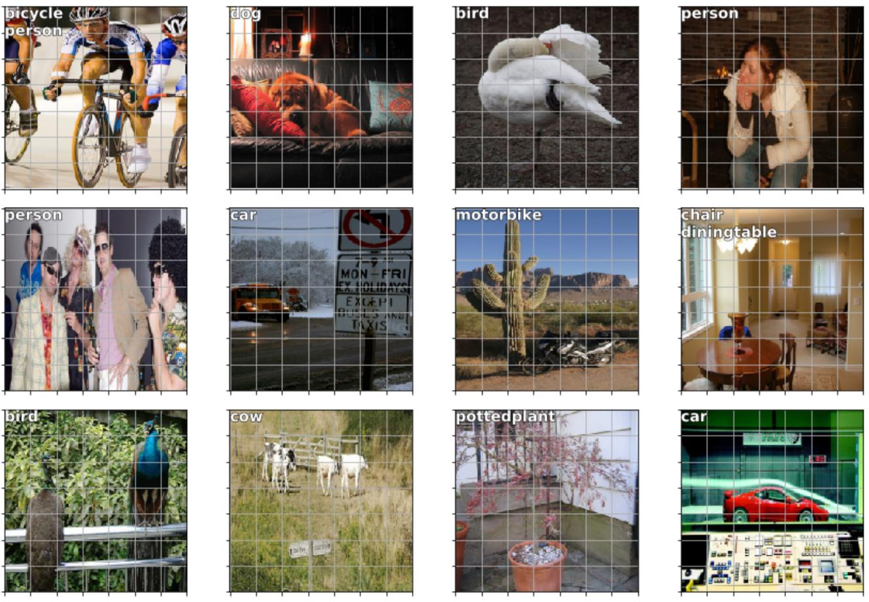
We already know how to do multi-label classification

Slide 19
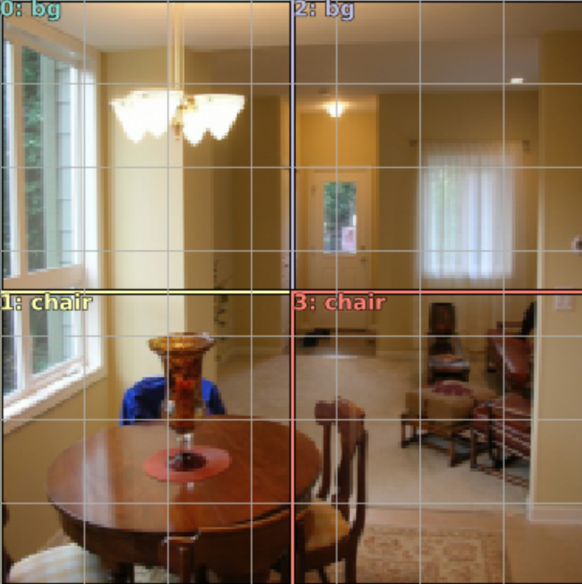
To predict multiple bounding boxes, we’ll need to create a number of anchor boxes

Slide 20
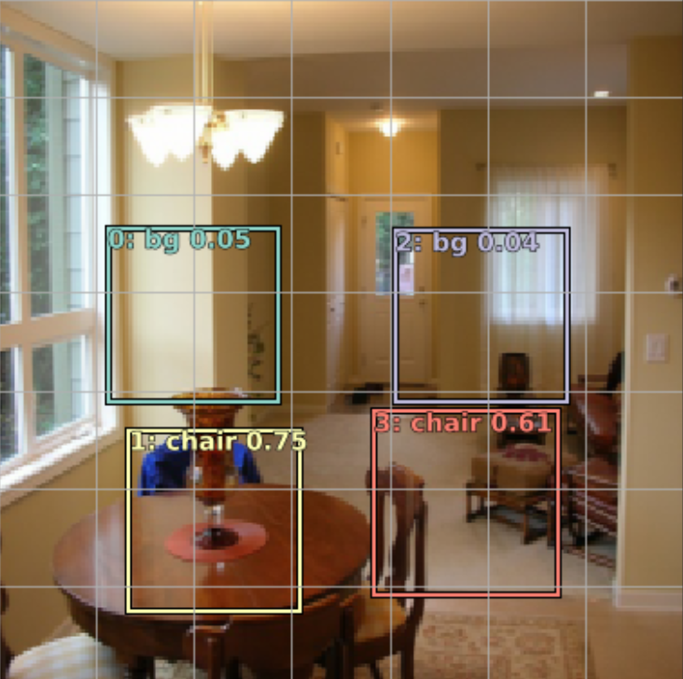
The network will output activations representing the offset of each object’s bounding box from the nearest anchor box

Slide 21
There’s a rich history to this idea
Scalable Object Detection using Deep Neural Networks (Multibox)
Faster R-CNN: Towards Real-Time Object Detection with Region Proposal Networks*
You Only Look Once: Unified, Real-Time Object Detection
SSD: Single Shot MultiBox Detector
Focal Loss for Dense Object Detection (RetinaNet)
* 2 stage approach

Slide 22
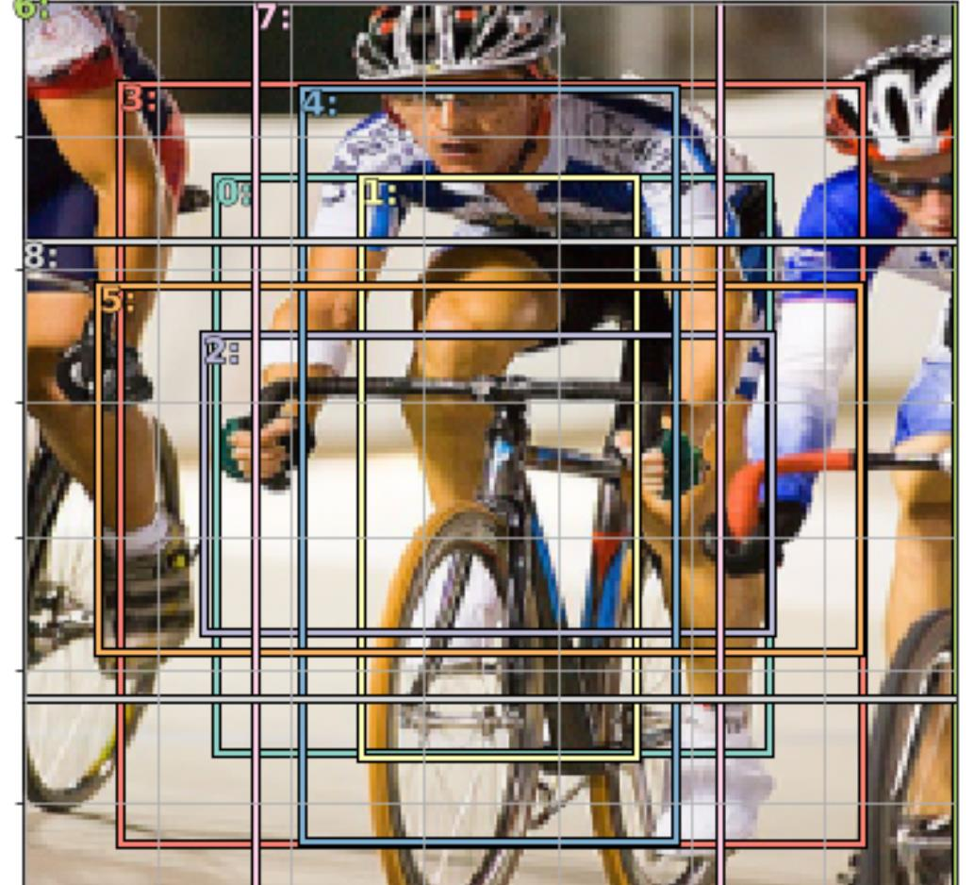
To improve the model, we’ll create multiple anchor boxes of different sizes and aspect ratios

Slide 23
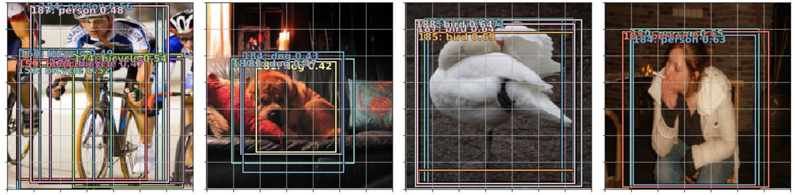
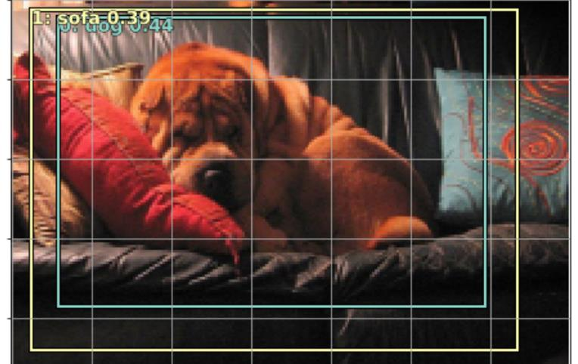
We can then just keep the ones that have probability > x, and then remove overlapping boxes

